Slide 1
Quick sort
By
Tanvir Ahammad
Lecturer
Dept. of JnU, Bangladesh

Slide 2
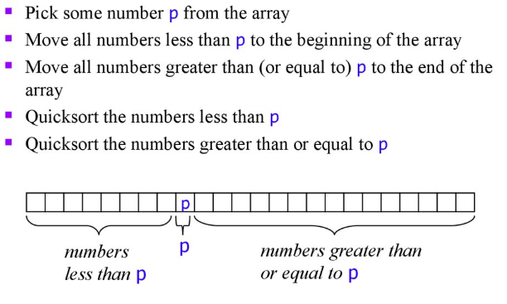
Basic idea about quick sort

Slide 3
Partitioning
It is most important phase
Every time portioning happens and then places the pivot in its right place
This process continues recursively and solve the problem as divide and conquer fashion, i.e.
Divide: divide (partition) the array into two sub arrays
Conquer: Sort the sub arrays by calling quick sort recursively
Combine: As the sub arrays are sorted, no need to perform any work in this step. The array A[i…j] is sorted

Slide 4


Example-partitioning
$p→beggining index;$
$r→ending index$;
$i→partioned index;$
$j→loop counter$

Slide 5

Example-partitioning
$p→beggining index;$
$r→ending index$;
$i→partioned index;$
$j→loop counter$

Slide 6

Example-partitioning
$p→beggining index;$
$r→ending index$;
$i→partioned index;$
$j→loop counter$

Slide 7

Example-partitioning
$p→beggining index;$
$r→ending index$;
$i→partioned index;$
$j→loop counter$

Slide 8

Example-partitioning
$p→beggining index;$
$r→ending index$;
$i→partioned index;$
$j→loop counter$

Slide 9

Example-partitioning
$p→beggining index;$
$r→ending index$;
$i→partioned index;$
$j→loop counter$

Slide 10

Example-partitioning
$p→beggining index;$
$r→ending index$;
$i→partioned index;$
$j→loop counter$

Slide 11
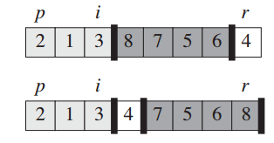

Example-partitioning
$p→beggining index;$
$r→ending index$;
$i→partioned index;$
$j→loop counter$

Slide 12
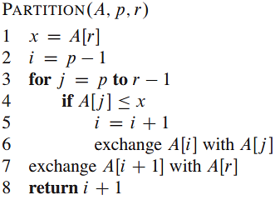
Partitioning procedure

Slide 13
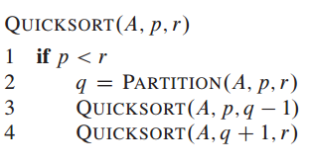
Quick sort algorithm
To sort array using this algorithm, the initial call should be QUICKSORT(A, 1, A.length)

Slide 14

Analysis of quick sort
Initialization
Maintenance
Termination

Slide 15
Exercise
Illustrate the operation of PARTITION on the array A={13; 19; 9; 5; 12; 8; 7; 4; 21; 2; 6; 11}

Slide 16
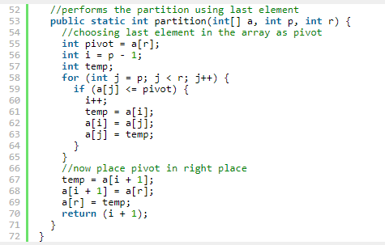
Pseudocode

Slide 17
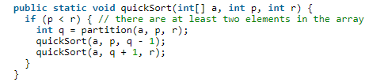
Pseudocode

